Slide 1
Shield insurance
Sales mode & Customer Insights
Tools used : Microsoft power Bi
Domain: Insurance Analytics
Focus :Sales mode performance ,customer segmentation , revenue and customer trends
By
Devendra kumar
https://www.linkedin.com/in/devendra-analyst

Slide 2
Core Service
Shield insurance provide a variety of insurance policies including health ,life, and general insurance

Slide 3
Operations
Sales and premium (payment)tracking's
Performance analysis of policies and claims

Slide 4
Shield insurance uses multiple sales distribution channels
Offline –agent :Policies sold through licensed agents who assist customers during purchase
Offline-direct : Policies sold directly at company branches
Online-Apps: Policies purchased through the company’s mobile application
Online-website: Policies purchased through the company’s official website

Slide 5
Customer base
Delhi NCR
Hyderabad
Indore
Chennai
Mumbai

Slide 6
Policies Offered
Each policy has a unique policy_id:
POL4321HEL
POL4331HEL
POL3309HEL
POL5319HEL
POL6303HEL
POLG093HEL
POL9221HEL
POL1048HEL
POL2005HEL
Includes a base cover amount (sum insured)
Associated with a base premium amount (INR) to be paid by the customer
Tracked across dates, customers, and sales modes

Slide 7
Main focus /problem statement
Top-performance Sales modes by revenue
Trends In customer acquisition and revenue
Customer distribution by age group and city
High-demand policies and age segments

Slide 8
Power BI dashboard link :
https://app.powerbi.com/groups/me/reports/424addbf-5ec0-48bf-abbc-9e86d41ec127/a643b053bc0b018ec54e?experience=power-bi

Slide 9
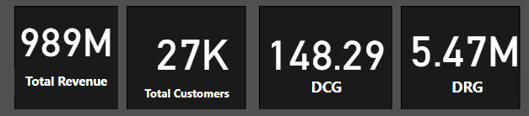
Overall Business Performance
Recommendation:
Business is performing strongly in terms of revenue and customer volume.

Slide 10
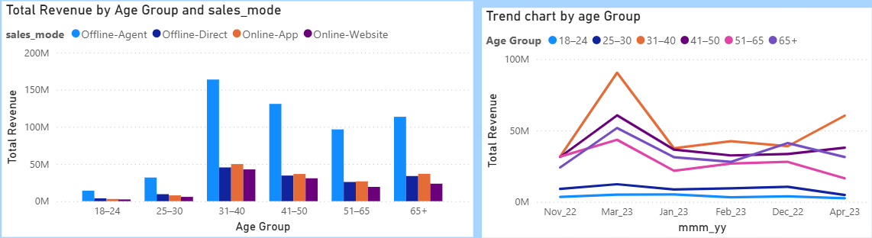
Customer Distribution
Age Group Insights:
31–40 age group dominates in both revenue (₹311M) and customer count (10.4K).
39% of customers are aged 31–50 (10.5K + 6K customers).
They generate ~₹530M+ in premium (over 53% of total revenue)
. 18–24 group has lowest engagement (₹25M, 1.8k customers).
Recommendation:
Focus resources and offers on 31–40 segment for short-term gains.
Experiment with youth-targeted policies, gamification, or student bundles for 18–24 group.

Slide 11
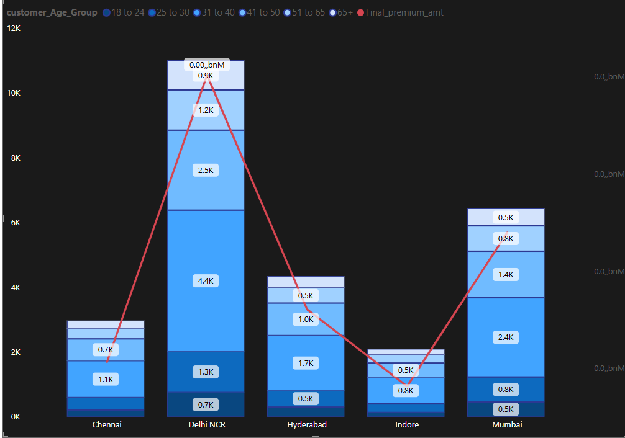
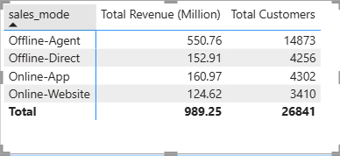
Customer Distribution by city and age
Delhi emerges as the highest revenue-contributing city with ₹401 Mn, followed closely by Mumbai, highlighting a strong concentration of revenue generation in major metropolitan markets.
Recommendations
Implement city-specific marketing strategies in high revenue-per-capita cities to maximize return on marketing investment and strengthen brand penetration.
Establish localized partnerships and agent networks in top-performing cities to expand reach, improve customer acquisition, and drive sustainable revenue growth.

Slide 12
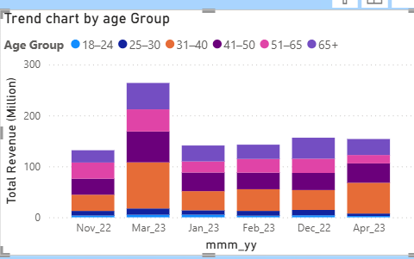
Customer & Revenue Trend
Revenue is highest in March, likely due to end-of-financial-year buying. A drop is seen in April, which may be caused by seasonal factors or fewer renewals.

Slide 13
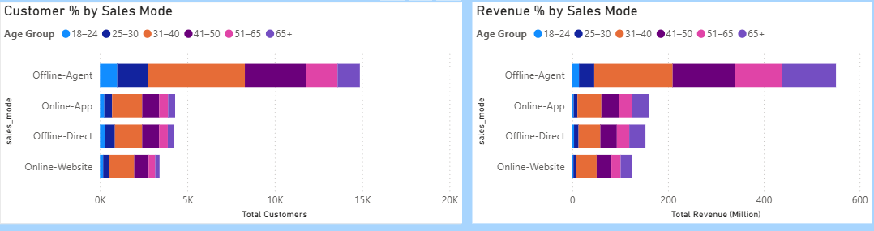
Sales Channel Performance
The Offline–Agent channel is the top revenue driver, contributing nearly 56% of total revenue, showing strong customer trust and conversion.
Online App and Website channels together generate about 29% of revenue and offer lower operational costs with high scalability potential.
Offline-Direct channel is mainly effective for bulk and corporate sales but shows lower efficiency in retail segments.

Slide 14
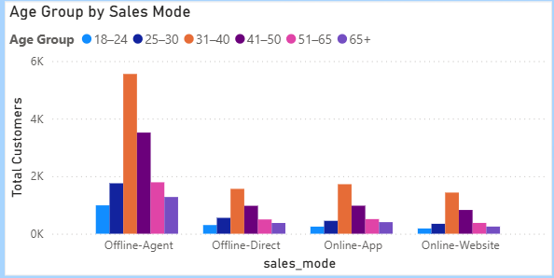
Age Group Analysis by Sales mode
Key Insights
Younger users (18–30) show a strong preference for the Online App channel.
Older users (41+) primarily prefer the Offline Agent channel, indicating higher trust in human-assisted interactions.
Online App and Website channels are currently underutilized, but have strong growth potential, especially among younger segments.

Slide 15
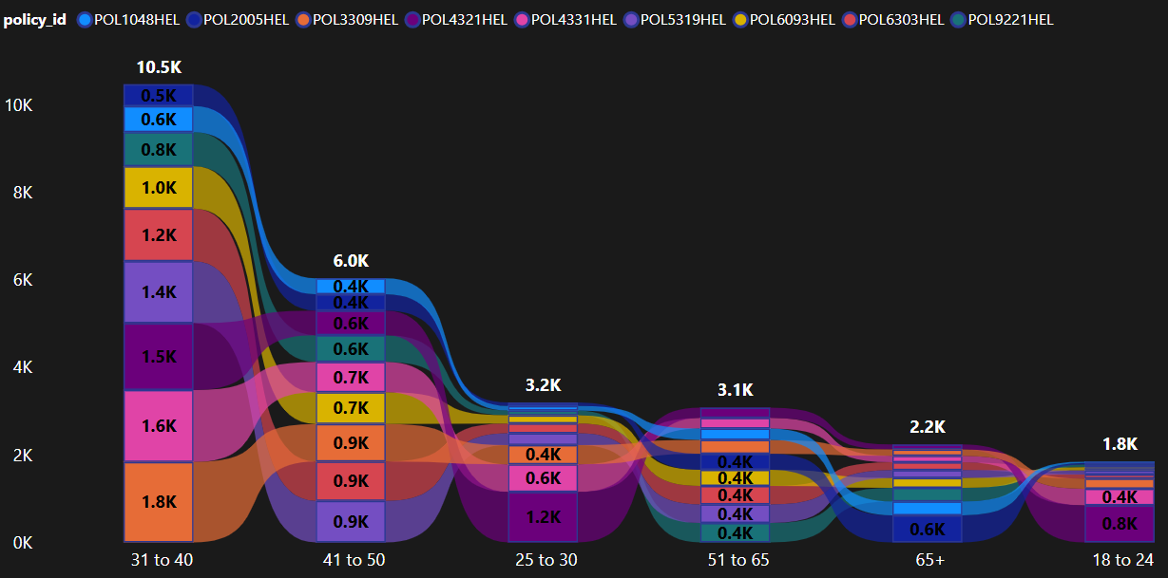
Product Sales Performance
Total Policies Sold:
Most policies sold to 31–40 (10.5K), followed by 41–50 (6K).
Sales drop after 50+, especially for 65+ and 18–24.
Recommendation:
Offer family or retirement policies for 50+ segment.
Introduce entry-level products or free trials for 18–24 segment.
Phase out underperforming policies or bundle them with top-performing ones.

Slide 16
Recommendations
Increase digital awareness and adoption among mid-to-young customer segments through targeted online campaigns and in-app promotions.
Refine and personalize policy offerings based on age-group preferences to improve conversion and retention.
Audit and validate revenue reporting by age group to ensure accuracy and better segment-level decision-making.
Launch focused promotional campaigns in Q4 to replicate the strong revenue performance typically seen in March.
Train offline agents to actively promote digital channels, enabling gradual customer migration and improving operational efficiency.

Slide 17
Thank you!

